Slide 1
HUMAN BODY SYSTEMS!
Remember CTOS…
Cells: the smallest basic unit of life
Tissues: a group of similar cells working together to perform a specific function
Organs: a group of different tissues working together to perform a specific function
Systems: a group of organs working together to maintain homeostasis within the body
Homeostasis: a state of balance within the body

Slide 2
There are 4 Types of Tissue: Epithelial-- functions as a boundary. It covers each of your internal organs. Nerve-- Messaging system; Carries electrical impulses from your brain to various parts of your body Muscle-- Movement; controlled and uncontrolled Connective– Holds parts of the body together; Provides support, protection, strength, padding and insulation

Slide 3
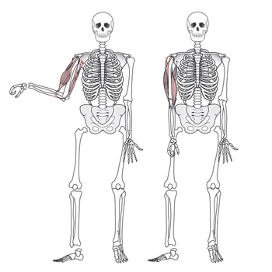
Skeletal System
We have 300 bones at birth but only have 206 bones as fully developed adults. Why do you think this may be??

Slide 4
Functions of the skeletal system
Serves as the anchor for all of the body’s movements
Provides support
Protects soft organs inside of the body.
3 Types of Bones!
Long – arms and legs Short- feet and hands
Flat- ribs and skull

Slide 5
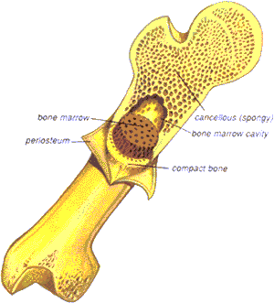
Bone Tissue
Compact bone = Hard layer on outside of bones Gives support
Spongy bone= Strong but lightweight.
Calcium network is less dense.
Marrow is found here!
Marrow= Produces red blood cells. These bring nutrients to the bone cells and carry wastes away.

Slide 6
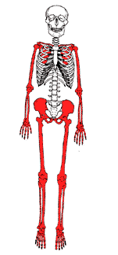
Axial vs. Appendicular Skeleton
Central part of skeleton
Includes skull, spinal column, and ribs
Main function is to provide support and protection
Attached to axial skeleton.
Includes bones of the shoulders, hips, arms, and legs.
Main function is to allow movement.
Made of bones
Provides body’s shape.
Axial Skeleton Appendicular Skeleton

Slide 7
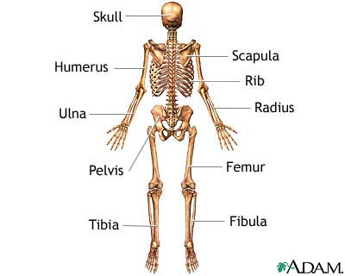
Vertebrae
Patella

Slide 8
Our skeleton changes as our body develops and ages!!
Bones are living tissue! They grow as the rest of the body grows!!
Infancy: newborns are born with spaces in their skulls. As the brain grows, these spaces begin to close.
Adolescence: toward the end of adolescence, bones stop growing. The growth plate is the last portion of the bone to become hard. Once growth plates become hard, arms and legs stop growing.
Adulthood: When bones stop growing, they go through cycles in which old one is broken down and new bone is formed. As people age, more is broken down then is formed and this can cause bones to break more easily.

Slide 9
There are 3 types of joints→
Immovable – locks bones together like puzzle pieces.
Slightly Movable- are able to flex slightly.
Freely Movable- allows our bodies to bend and move.
SKULL RIBS ARMS/LEGS

Slide 10
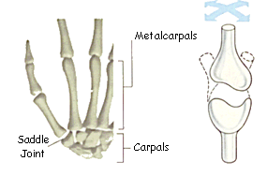
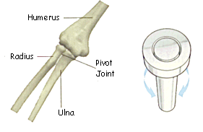
Glide Joint The bones in the wrists and ankles slide against each other in a gliding motion. Try out this joint by holding either right above your wrist or ankle and moving it to the right and left, and up and down. The gliding joint gives your wrists and ankles lots of freedom so you can really move around
Pivot Joint The first two vertebrae in your neck and the joint beneath your elbow move in a semicircle motion by twisting against each other. Try this first by holding your forearm and shoulder stationery, and notice that the bottom part of your arm can move in a semi circle back and forth. You can do the same thing with your vertebrae by holding the lower part of your neck, and rotating you head.

Slide 11
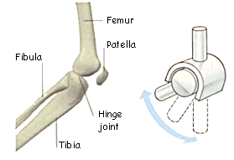
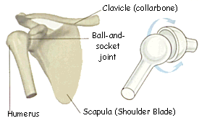
Hinge Joint The bones in the knees, elbows, fingers, and toes move just like the hinges on a door. If you're not quite clear on how they work, find the closest door and swing it back and forth. Notice that movement is somewhat limited, and it can only swing back and forth. Now try the same thing on your knees, elbows, fingers, and toes.
Ball and Socket The ball and socket joint allows your arms and hips to move in many directions. Try it! Up Down, right left, and a full 360° rotation give you a lot of freedom to get you where you want to go! Examples include the shoulder and hip.

Slide 12
Joints connect parts of the skeletal system
How many bones are in your hand?
Use a pencil to trace an outline of your hand on a piece of paper. Feel the bones in your fingers and the palm of your hand. At points where you can bend your fingers and hand, draw a circle. Each circle represents a joints where two bones meet. Draw lines to represent the bones in your hand.
How many bones did you find? How many joints did you find?
19 14

