Slide 1
Muscular System

Slide 2
Functions
COPY THIS ENTIRE SLIDE IN YOUR NOTES
1. Movement
Muscle fibers contract and relax
They work in pairs
Muscles on one side of bone contract while pulling on other side
2. Maintain Body Temperature
Release heat when they contract to maintain homeostasis (shivering)
3. Maintain Posture
Most muscles are partially contracted all the time
Muscles make constant adjustments

Slide 3
Different Types of Muscles
COPY THIS ENTIRE SLIDE IN YOUR NOTES
1. Skeletal Muscle
Voluntary (chosen movement)
Have long fibers that produce slow-twitch muscles for slow movement
Have long fibers that produce fast-twitch
muscles for quick movement

Slide 4
COPY THIS ENTIRE SLIDE IN YOUR NOTES
2. Smooth Muscle
Involuntary– they perform automatic
movement
You have no control over these muscles
They contract slowly
Ex: Digestion is controlled by smooth muscle

Slide 5
COPY THIS ENTIRE SLIDE IN YOUR NOTES
3. Cardiac Muscle (heart)
Involuntary
These muscle cells contract slowly except in
an emergency

Slide 6
COPY THIS ENTIRE SLIDE IN YOUR NOTES
Connective Tissues
Tendons are a connective tissue that attach muscle to bone
Ligaments are a connective tissue that attach bone to bone
Cartilage is the cushion between your bones that acts as a shock absorber

Slide 7
Muscle Growth and Healing
Muscle cells reproduce with regular exercise
Muscles get bigger with increased activity
Sore muscles are due to damaged fibers during exercise or activity
Healing occurs when injured cells are removed and new ones are formed

Slide 8
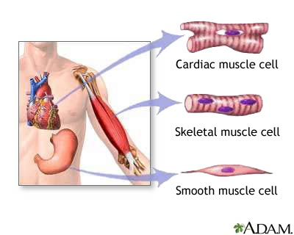

Slide 9
Voluntary or Involuntary
1. Lifting 2. singing 3. whistling
4. Digestion 5. breathing 6. Climbing
7. Running 8. swallowing 9. Choking

