Slide 1
THE NERVOUS SYSTEM

Slide 2
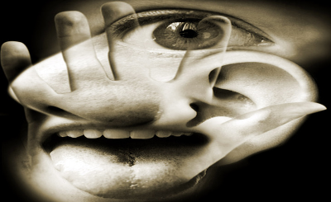
Senses
In order for humans to survive, their bodies must constantly monitor the environment
Sense organs interact with the nervous system to enable you to see, smell, touch, hear, and taste
A stimulus is a change in your environment that you react to
Loud music, hot food, bright lights, etc…
The brain interprets the changes

Slide 3
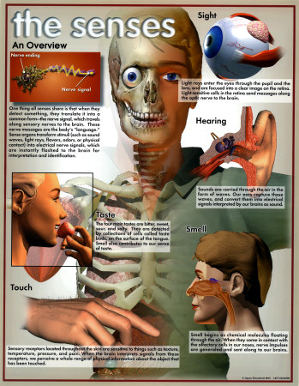

Slide 4
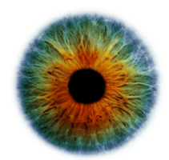
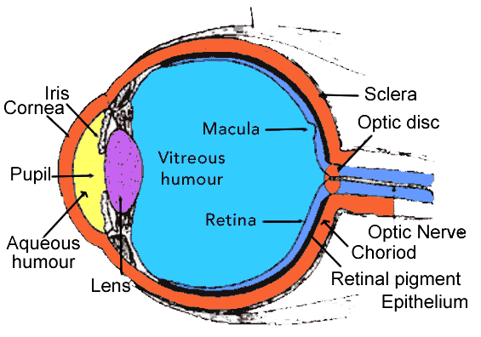
Sight
What would life be like if you could not see?
What do you need to see?
Light is the stimulus that enables sight
Eyes capture light and help turn it into an image that is processed by the brain
Muscles in the pupil alter its size allowing more or less light to enter the eye
In the back of the eye is the retina
The retina is composed of rods and cones
Rods detect changes in brightness
Cones are sensitive to color

Slide 5
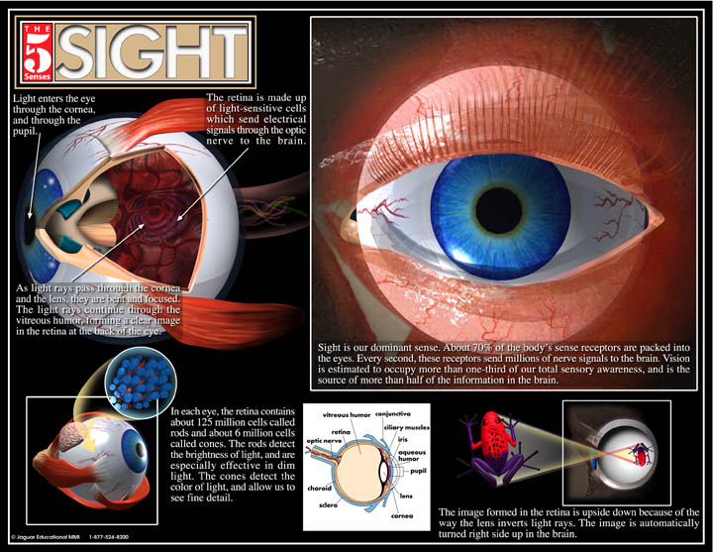

Slide 6
Hearing
Sound waves are attributed to vibrations
Your vocal cords vibrate to make sounds
Many vibrations are too low or high to be heard by humans (dog whistle)
Sound waves pass through the ear to the ear drum which vibrates when the waves hit it
Pressure caused by the vibrations causes fluid in the ear to move
The movement of the fluid results in signals sent to the brain that are interpreted as sound

Slide 8
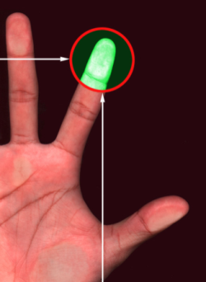
Touch
Depends on tiny sensory receptors in the skin
Without the receptors, we would not feel pressure, temperature, or pain
Nerves near the top of the inner layer of your skin (dermis) sense textures like smooth glass or concrete
Nerves deeper in the dermis sense pressure
The sense of touch is very important in
alerting your body of danger

Slide 10
Smell
Smell involves detecting chemical information from the environment
Scent receptors sense chemicals in the air
In the back of your nose are hair-like fibers covered in mucus
Molecules that enter the nose stick to the mucus and then bind to the receptors in the hair-like fibers
The receptors send an impulse to your brain so that you can perceive the scent

Slide 11
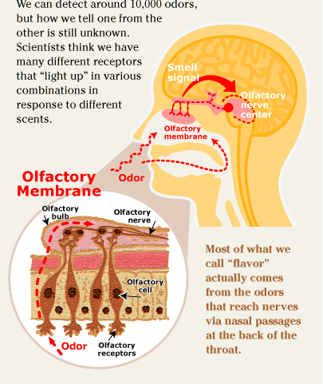

Slide 12
Taste
Your tongue is covered with small sensory receptors called taste buds
Also found in the throat and on the roof of the mouth
Have you ever had a dead taste bud?
Each taste bud includes about 100 sensory cells
The receptors detect four general tastes: sweet, sour, bitter, and salty
The thousands of tastes that you experience are also partially due to sense organs in your nose
Ever eat something while plugging your nose?
That is why when you have a cold, your ability to taste decreases

Slide 13
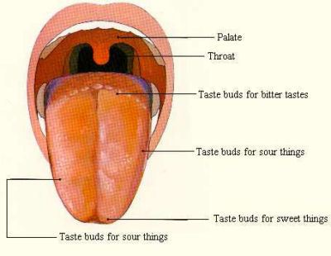
Taste

Slide 14
Parts of the Nervous System
Two major parts of the nervous system:
Central Nervous System
Brain
Spinal Cord
Peripheral Nervous System
Nerves throughout the body

Slide 15
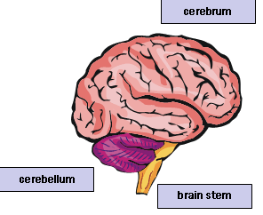
Central Nervous System: The Brain
The brain:
Contains nearly 100 billion nerve cells called neurons
Controls voluntary behavior like walking and thinking, and also controls involuntary responses like heartbeat, blood pressure, and fluid balance.
Every area of the bran has a specific function.
Three major parts of the brain:
Cerebrum- most of the mass of your brain
Memory, thinking, feeling, movement
Cerebellum
Coordination and balance
Brain stem
Connects brain to spinal cord
Controls involuntary functions like breathing and heart beat

Slide 16
Central Nervous System: Spinal Cord
The spinal cord
Main pathway for information, connecting the brain to nerves throughout your body
Protected and supported by the spinal column
Connected to the brain by the brain stem
31 pairs of nerves are connected that send sensory impulses into the spinal cord to the brain, and spinal nerves send impulses out to the body

Slide 17
Peripheral Nervous System
The nerves found throughout the body are often referred to all together as the peripheral nervous system.
Sensory nerves- receive information from the environment (like heat or cold) and send it to the CNS.
Motor nerves- send signals to your muscles that allow you to move.
Includes both voluntary nerves and involuntary responses.

Slide 18
Autonomic Nervous System
Controls the movement of the heart, smooth muscles of the stomach and intestines, and the glands.
2 major functions:
To conserve and store energy
To respond quickly to changes
Responsible for the “fight or flight” response when you’re under stress.
CONTROLS INVOLUNTARY MOVEMENTS!

Slide 19
Voluntary Nervous System
Monitors movement and functions that can be controlled voluntarily.
Controls the skeletal muscles of the arms, legs, and rest of body, and controls muscles that are responsible for speech and the senses.

Slide 20
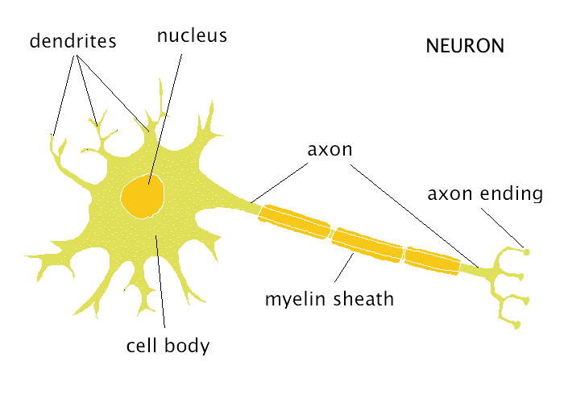
Parts of the Neuron
Dendrites- takes information to the cell body
Cell body- part of the neuron that contains the nucleus
Nucleus- contains genetic information for the neuron
Axon- takes information away from the cell body
Myelin sheath- fatty material that surrounds the axons
Synapse- where two nerves meet

Slide 21
Types of Nerves
Sensory nerves- send messages to the brain
Motor nerves- send messages from the brain

