Slide 1
Earths Atmosphere

Slide 2
Key Vocabulary
Exosphere- Composed of light gases such as helium and hydrogen.
Mesosphere- Coldest Layer of the atmosphere. Contains strong winds, and is were meteors are found.
Ozone- Layer of the atmosphere that’s formed when an additional third oxygen atom is attached to an oxygen molecule creating ($o_{3})$.
Radiation- The transfer of energy through space by visible light, ultraviolet radiation, and other forms of electromagnetic waves.
Electromagnetic Waves- A wave produced by the acceleration of an electric charge and propagated by the periodic variation of intensities of, usually, perpendicular electric and magnetic fields.

Slide 3
Key Vocabulary
temperature inversion- A thin layer of the atmosphere where the temperature begins to increase with the height.
Thermosphere- The farthest layer from the surface and contains a very small part of the atmosphere’s mass.
Troposphere- The closest layer to the Earth’s surface. This layer contains the most atmosphere mass, including the water vapor.
Conduction- The transfer of energy that occurs when molecules collide with one another.
Convection- The transfer of energy by the flow of a heated substance.

Slide 4
Key Vocabulary
Temperature- A measurement of how rapidly or slowly molecules move around.
Heat- The transfer of energy that occurs because of a difference in temperature between two or more substances.
Saturation- When the air holds as much water vapor as it possibly can.
Dew Point- The Temperature to which air must be cooled at constant pressure to reach saturation.
Condensation- When matter changes state from gas o a liquid.

Slide 5
Introduction to Atmosphere Layers
Layers of the Atmosphere {Video}
Red Bull Sky Diving {Video}

Slide 6
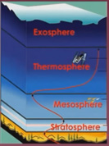
Atmospheric Composition
Lower Atmospheric Layer(s)
The Troposphere-
Contains the highest percentage of the atmospheric mass.
The location where most of the weather takes place in and where the majority of the air pollution collects.
Altitude- 0-10 miles (0-12km)
The layer of the atmosphere we live in.

Slide 7
Atmospheric composition
Lower Atmospheric Layer(s)
The Ozone-
Located within the Stratosphere
Protects the earths surface from Solar Radiation.
Highest Concentration Altitude- 12-30 miles (20-50km)
The Stratosphere-
The layer where the Ozone is located.
Referred to as the Stratospheric Ozone.
Altitude- 10-30 miles (12-50km)
Planes like to fly in this layer of the atmosphere because the is less moisture, which means less clouds and weather= Less turbulence.

Slide 8
Atmospheric composition
Upper Atmospheric Layer(s)
The Exosphere-
The uppermost layer of the atmosphere.
Atmosphere begins to thin out and merges with outer space.
Altitude- 370 miles and beyond (600+km)
The Thermosphere-
The farthest layer from the earths surface.
Very little atmospheric mass.
Altitude- 50-370 miles (80-600km)
The Mesosphere-
The coldest layer of the atmosphere.
Location where shooting stars (meteor shootings occur).
Altitude- 30-50 miles (50-80km)

Slide 9
Atmospheric composition
Deeper Look Into the Thermosphere
Has two portions (ionosphere, and Exosphere)
Ionosphere-
Radio Communication takes place here.
Location in which the Aurora Bolealis and Aurora Australis (Northern Lights/ Southern Lights) occurs.
Aurora Bolealis {Video}

Slide 10
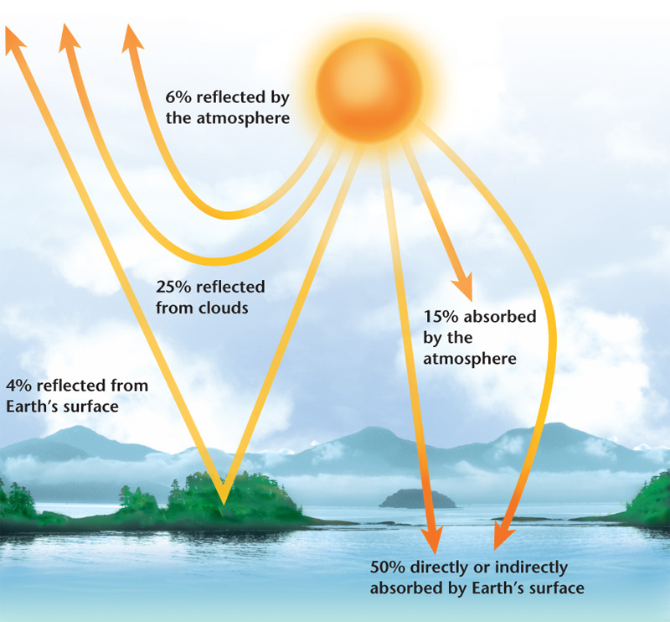
Radiation
35% of the suns radiation is reflected back to outer space.
4% is reflected from the Earth’s surface.
6% is reflected by the atmosphere.
25% is reflected by the clouds.
65% of the suns radiation is absorbed.
15% is absorbed by the atmosphere.
50% is absorbed either directly or indirectly by the Earth’s surface.
Creates the warmth of the atmosphere and provides temperature to maintain life by conduction and convection.

Slide 11
Radiation Conduction/ Convection
Radiation Conduction
Energy is transferred from the particles of the air near the Earths surface to the particles of the air in the lower layer of the atmosphere.
For conduction to occur, substance must be in direct contact with one another.
ONLY AFFECTS a very THIN atmospheric layer near the Earths surface.
Radiation Convection
Pockets of air near the Earth’s surface are heated, and become less dense than its surrounding air, and rise.
As the warm air rises, it expands and beging to cool.
Once it cools below the temperature of its surrounding air, it increases in density and sinks.
The main mechanisms responsible fo the vertical motions of air, which in turn cause the different types of weather.

Slide 12
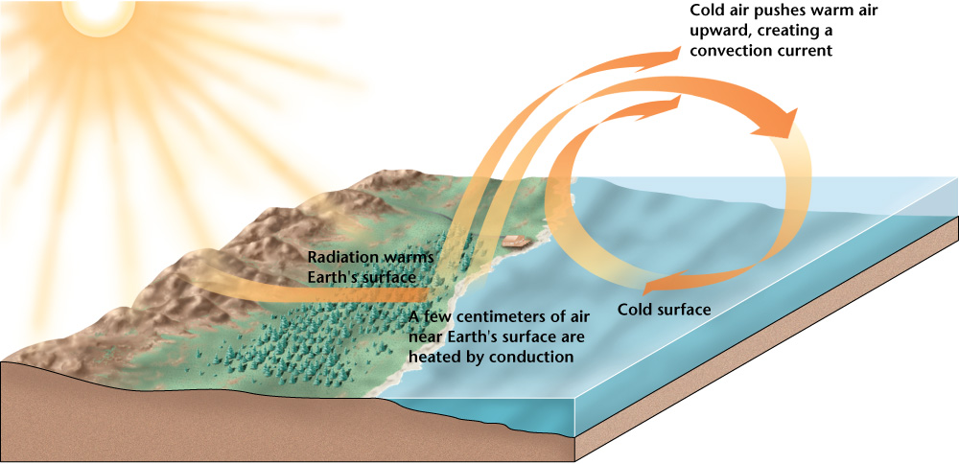

Slide 13
State of the Atmosphere
Temperature Versus Heat
Temperature- Measurement of ho rapidly or slowly molecules move around.
Heat- The transfer of energy that occurs because of a difference in temperature between two or more substance.
*IMPORTANT*
HEAT is the transfer of energy that fuels the atmospheric processes, while TEMPERATURE is used to measure and interpret that energy.

Slide 14
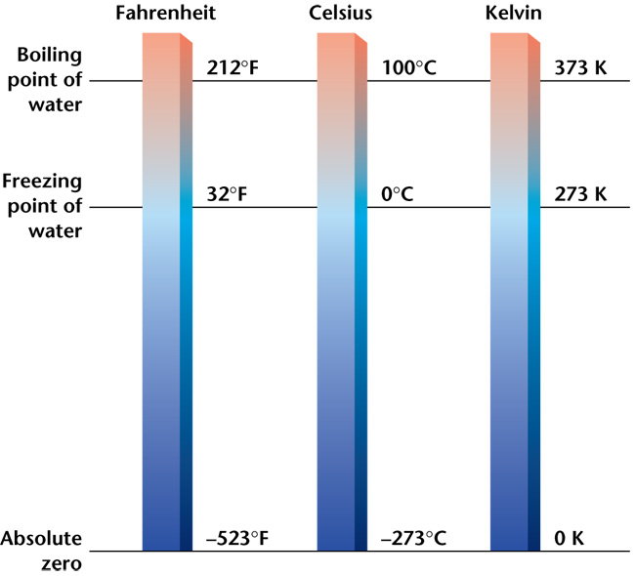
State of the Atmosphere
Temperature Versus Heat
Measuring Temperature
- Temperature can be measured in degrees Fahrenheit (ºF), in degrees Celsius (ºC), or in kelvins (K), the SI unit of temperature.
- The Kelvin Scale measures the number of kelvins above absolute zero, a point where molecular motion theoretically stopsl

Slide 15
State of the Atmosphere
Temperature Versus Heat
Dew Point
- The Temperature to which air must be cooled at constant pressure to reach saturation.
Saturation
- Point at which the air holds as much water vapor as it possibly can.
Condensation
- When matter changes state from a gas to a liquid.

Slide 16
Air Components and Air pressure
What’s Air? {Activity}

Slide 17
Atmospheric Composition
Quick Video (Altitude, Air Density, and the Effects on the Human Body]

Slide 18
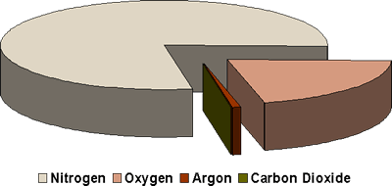
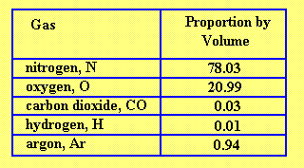
Components of air
What Components make up air?
Air is made up of five main gases
Nitrogen (N)
Oxygen (O)
Carbon Dioxide (CO2)
Hydrogen (H)
Argon (Ar)

Slide 19
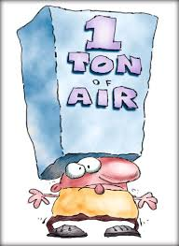
Air pressure
We don’t notice air pressure because we live our whole lives exposed to it.
Air Pressure is created from the gravitational attraction between the Earth and the atmospheric gases. This causes the particles of gas to be pulled towards the center of the Earth.
Changes in the air pressure cause changes in the weather.
High Pressure= Cold Air
Low Pressure= Warm Air

Slide 20
Air pressure Cont.
Atmospheric pressure decreases as the altitude increases. (There are fewer and fewer gas particles exerting pressure on a given area).

Slide 21
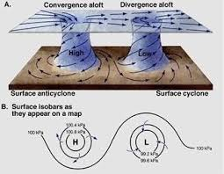
Relationship Between air pressure and wind
Wind
Air moves in response to density imbalances created by the unequal heating and cooling of the Earth’s Surface.
Creating areas of High and low Pressure
Wind is the air moving in response to differences in the temperatures. Air moves from areas of high pressure to areas of low pressure.
Wind speed increases with height in altitude because of there be less friction.

Slide 22
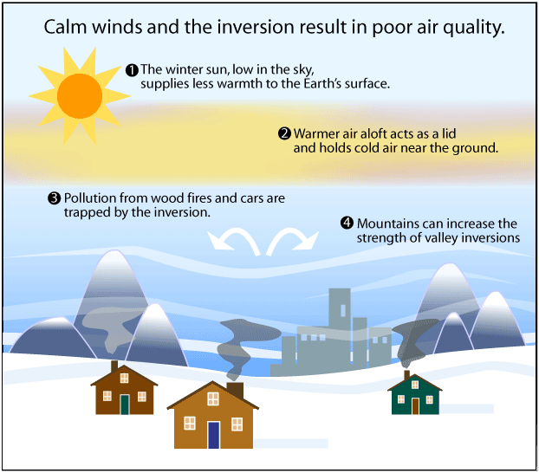
Air pressure- Temperature-Density relationship
Temperature Inversion
An increase in temperature with height in an atmospheric layer.
This can happen when a lower layer of atmosphere loses heat to the Earth’s surface and becomes cooler than the air above it.
Can act like a lid to trap pollution under the inversion layer.

