Slide 1
Review: Speed
Speed is the distance an object travels in a specific amount of time.
To calculate speed:
Speed = Distance ÷ Time
Distance is in meters (m)
Time is in seconds (s)
Speed is in meters per second (m/s)

Slide 2
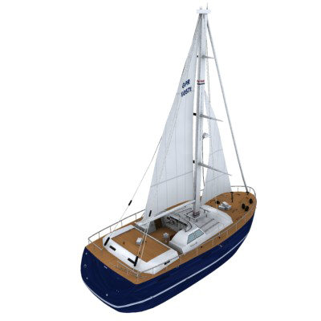
Velocity
Sometimes, knowing the speed isn’t enough.
For example, sailors must know the speed and direction their boat is travelling in.
Velocity is a description of both speed and direction.
e.g. a sailboat travelling at 20 kph in a SE direction

Slide 3
Velocity
Sometimes, knowing the speed isn’t enough.
For example, sailors must know the speed and direction their boat is travelling in.
Velocity is an example of a vector, a quantity that has both magnitude and direction.

Slide 4
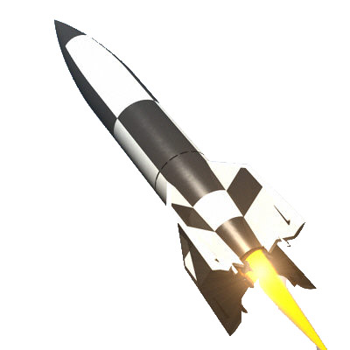
Acceleration
Objects can speed up, slow down or change direction.
Acceleration measures how much an object’s velocity changes over a certain time.
Acceleration can be:
A change in speed
A change in direction
Both

Slide 5
Acceleration
Acceleration can be positive, negative or zero.
Positive Acceleration
Object speeds up
Negative Acceleration
Object slows down
Zero Acceleration
Constant or no speed

Slide 6
Acceleration
Formula for acceleration:
Acceleration = Change in Velocity Time
Acceleration = ___V_{Final} _- V_{Initial}___ T
Velocity: meters per seconds (m/s)
Time: seconds (s)
Acceleration: meters per second squared (m/s²)

Slide 7
Special Topic
Part 4: Velocity-Time Graphs

Slide 8
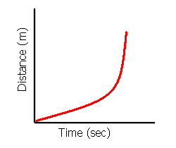
Interpret the Graph 1
Analysis:
The distance (m) from a reference point is increasing as time passes
This shows acceleration

Slide 9
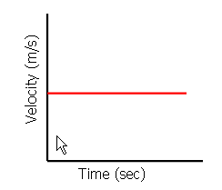
Interpret the Graph 2
Analysis:
The velocity (m/s) does not change over time
The object is at constant velocity
There is no acceleration

Slide 10
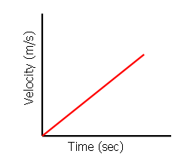
Interpret the Graph 3
Analysis:
The velocity is increasing as time passes
The object is accelerating
Since the line is straight, it shows constant acceleration

