Slide 1
Motion
Part 2: Distance-Time Graphs

Slide 2
Graphing Speed
The motion of an object can be graphed.
A distance-time graph shows the motion of a certain object in line graph form.
Time is plotted on the horizontal (X) axis
Distance is plotted on the vertical (Y) axis

Slide 3
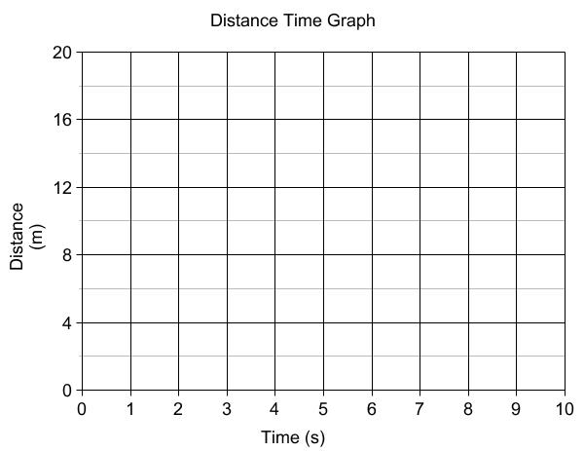
Distance-Time Graphs
The slope of a distance-time graph is the speed
Time (s) | Distance (m)
0 | 0
1 | 2
2 | 4
3 | 6
4 | 8
5 | 8
6 | 8
7 | 8
8 | 8
9 | 12
10 | 16

Slide 4
Distance-Time Graphs
S = D ÷ T
= 0 ÷ 4
= 0 m/s
S = D ÷ T
= 8 ÷ 4
= 2 m/s
S = D ÷ T
= 8 ÷ 2
= 4 m/s

Slide 5
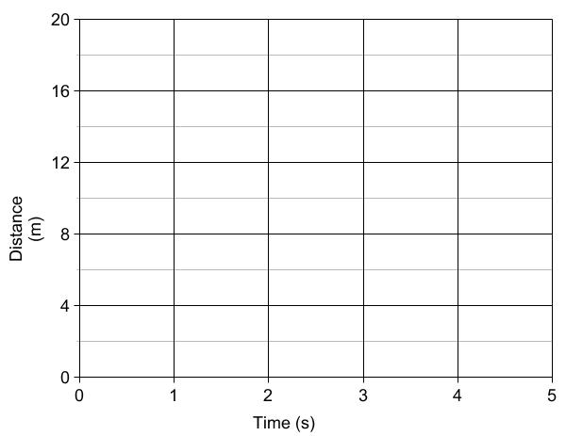
Distance-Time Graphs
Constant speed
(moving away)
Constant speed
(moving closer)
(and faster!)
No speed
(standing still)

Slide 6
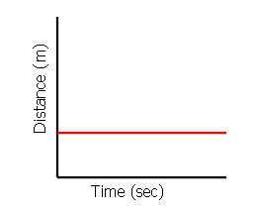
Interpret the Graph 1
Analysis:
The distance (m) stays the same as time goes by
The object is not moving (at rest)

Slide 7
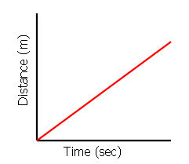
Interpret the Graph 2
Analysis:
The object’s distance from a reference point is changing with time
The object is moving away at a constant speed

Slide 8
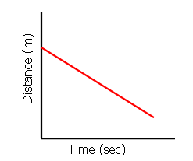
Interpret the Graph 3
Analysis:
The object’s distance from a reference point is changing with time
The object is moving towards at a constant speed

Slide 9
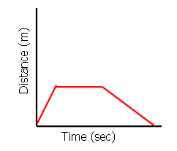
Interpret the Graph 4
Analysis:
In Part A, the object is moving away with a constant speed
In Part B, the object is at rest
In Part C, it is moving towards at constant speed
B
C
A

Slide 10
Motion
Part 3: Velocity and Acceleration

