Slide 1
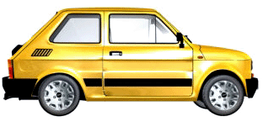
Example 2
A car drives 250 m in one minute.
Speed = Distance ÷ Time
Speed = 250 m ÷ 60 s
Speed = 4.17 m/s

Slide 2
Distance vs. Displacement
Distance and displacement are different.
Distance
How far an object moves in total.
Displacement
The distance and direction an object moves from a starting position.

Slide 3
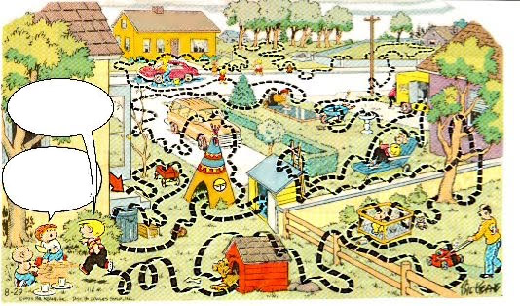
Distance vs. Displacement
Jeffrey, my distance was 176 meters!
But Billy, your displacement was 1 meter!

Slide 4
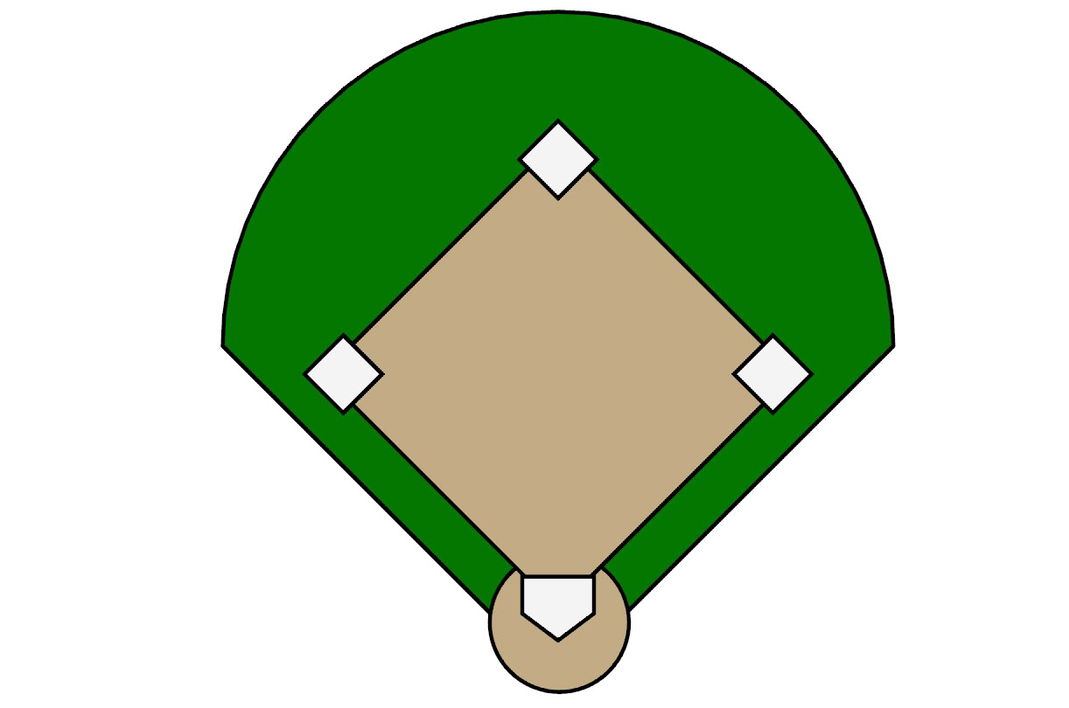
Distance vs. Displacement
90 ft.
Distance = 90 ft.
Displacement = 90 ft.

Slide 5
Distance vs. Displacement
90 ft.
90 ft.
Distance = 180 ft.
Displacement =127 ft.

Slide 6
Distance vs. Displacement
90 ft.
90 ft.
90 ft.
Distance = 270 ft.
Displacement = 90 ft.

Slide 7
Distance vs. Displacement
90 ft.
90 ft.
90 ft.
90 ft.
Distance = 360 ft.
Displacement = 0 ft.

